Slide 1


Restaurant Analysis of swiggy

Slide 2
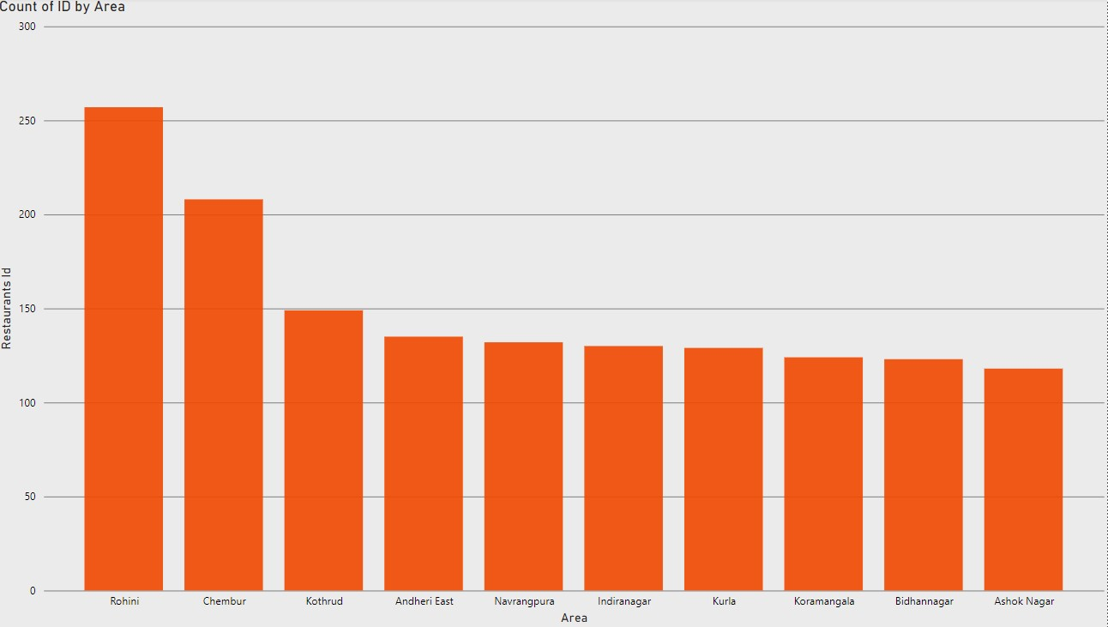
Top 10 Areas with the Most Restaurants
Analysis
The chart indicates that Rohini has the largest number of restaurants, significantly exceeding the other areas.
Chembur and Kothrud rank second and third, showing a consistent but slightly lower number of restaurants.
The remaining areas (Andheri East, Navrangpura, Indiranagar, Kurla, Koramangala, Bidhan Nagar, and Ashok Nagar) exhibit a relatively uniform distribution in restaurant counts.
Interpretation
Areas with a high density of restaurants often correspond to high population density, urbanization, and socio-economic factors such as higher disposable income or a preference for dining out

Slide 3
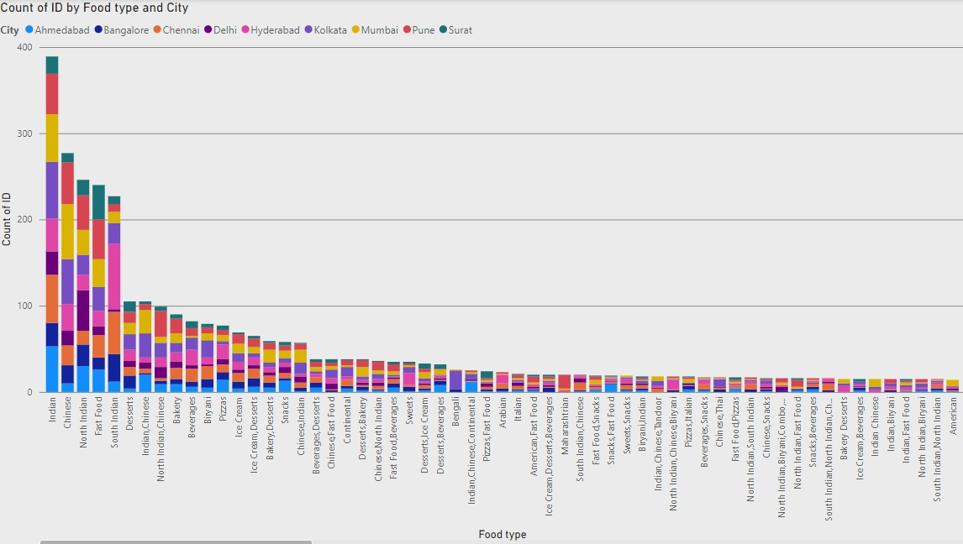
Determine the most popular food types served in each city
Analysis
Indian cuisine is the most popular food type across all cities, with a significant margin. This highlights the strong cultural preference for local and traditional flavors.
Chinese cuisine is the second most popular, showing its widespread acceptance and integration into urban food culture in India.
Interpretation
Indian cuisine being the most popular across cities emphasizes the strong cultural inclination toward local flavors.
The popularity of Chinese food points to its adaptability to Indian tastes, with dishes like Manchurian and noodles becoming staples.
Regional cuisines and fast food could be further explored in cities where they are less represented, to cater to niche audiences.

Slide 4
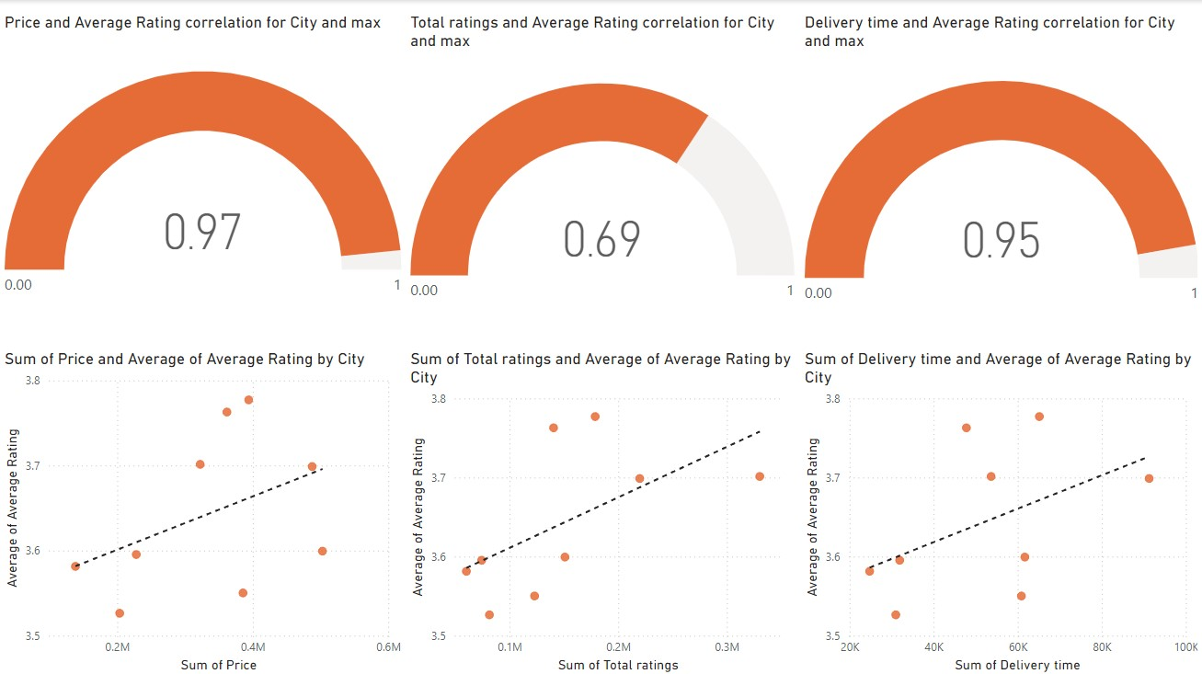
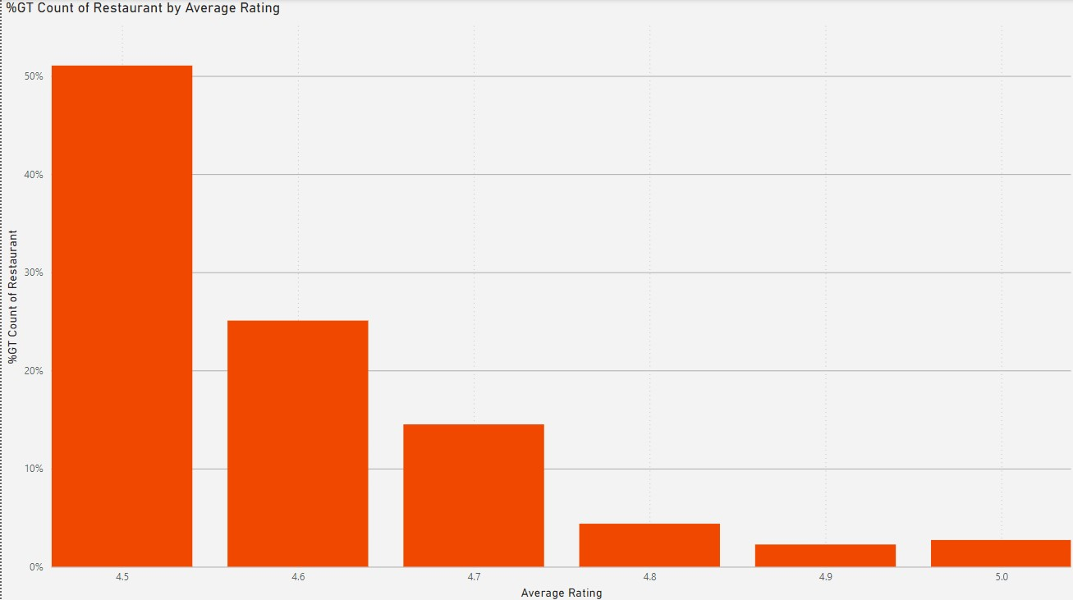
Top Rated Swiggy Restaurants (In Percentage)
Analysis :
More than 50% of the restaurants are rated 4.5
The percentage of restaurants decreases as the average rating increases beyond 4.5.
Ratings of 4.9 and 5.0 have the lowest counts.
Achieving perfect ratings is rare, which could indicate stringent customer expectations or fewer establishments consistently meeting the highest standards.
Interpretation:
Customer Satisfaction Norm:
Ratings clustering around 4.5 indicate a high general standard of customer satisfaction, but not exceptional across the board
Quality Differentiation:
Few restaurants score higher than 4.8, which could reflect how hard it is to consistently deliver extraordinary service or quality that impresses customers.
Competition and Perception:
The distribution hints at competitive pressures where most restaurants hover around similar quality perceptions.

Slide 5
Correlation of Factors Affecting Average Rating
Total Ratings vs. Average Rating (Correlation: 0.69):
A moderate positive correlation exists between the total number of ratings and the average rating.
Delivery Time vs. Average Rating (Correlation: 0.95):
A strong positive correlation between delivery time and average rating suggests that items with longer delivery times often receive better ratings.
Price vs. Average Rating (Correlation: 0.97):
There is a strong positive correlation between price and average rating.
Interpretation:
Price Impact:
Higher-priced items often receive better ratings, likely due to perceived quality. Businesses may consider offering premium-priced items for higher customer satisfaction.
Popularity and Ratings:
While popular items tend to receive good ratings, there is more variability. Businesses should ensure consistent quality across frequently ordered items to maintain high ratings.
Delivery Time:
The strong positive correlation suggests that customers are more forgiving of longer delivery times if the quality of food/service meets their expectations. However, businesses should ensure communication and transparency about delivery times.

Slide 6
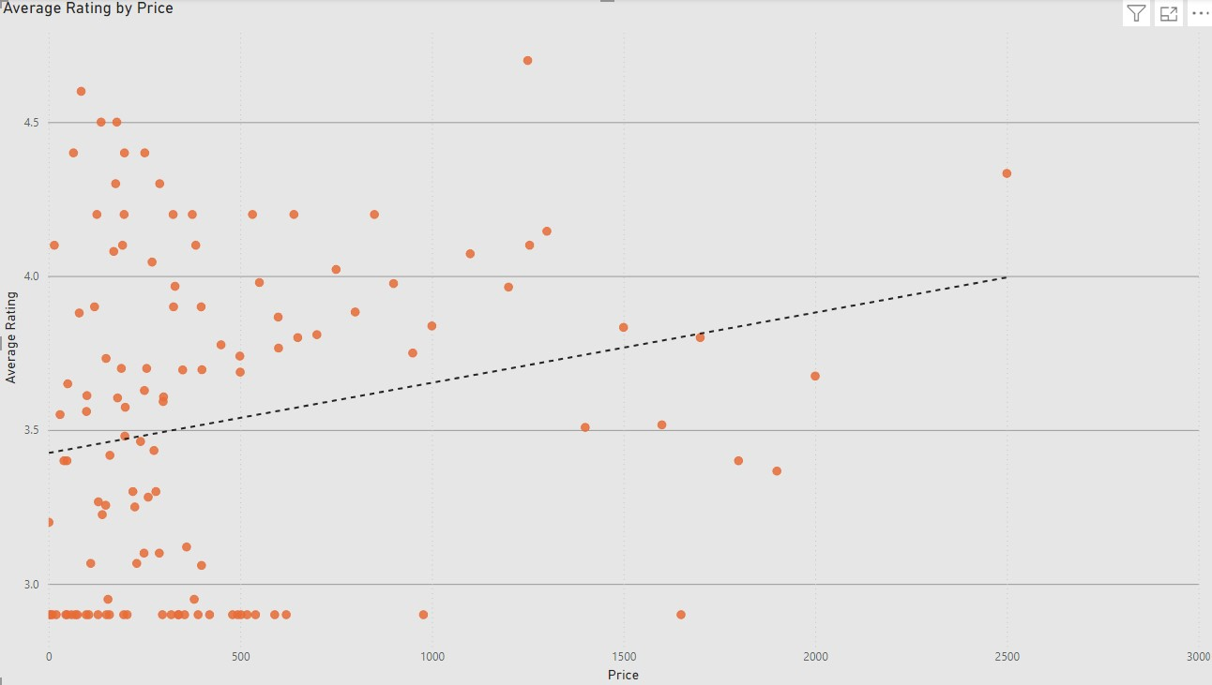
Correlation Between Restaurant Price and Average Rating
Analysis:
The dotted trend line shows a positive correlation between price and average rating. As the price increases, the average rating generally improves.
This suggests that higher-priced restaurants tend to receive higher ratings, possibly because customers associate higher prices with better quality or service.
Interpretation:
Premium Strategy:
Restaurants in the higher price range benefit from a perception of quality, justifying premium pricing strategies to enhance average ratings.

Slide 7
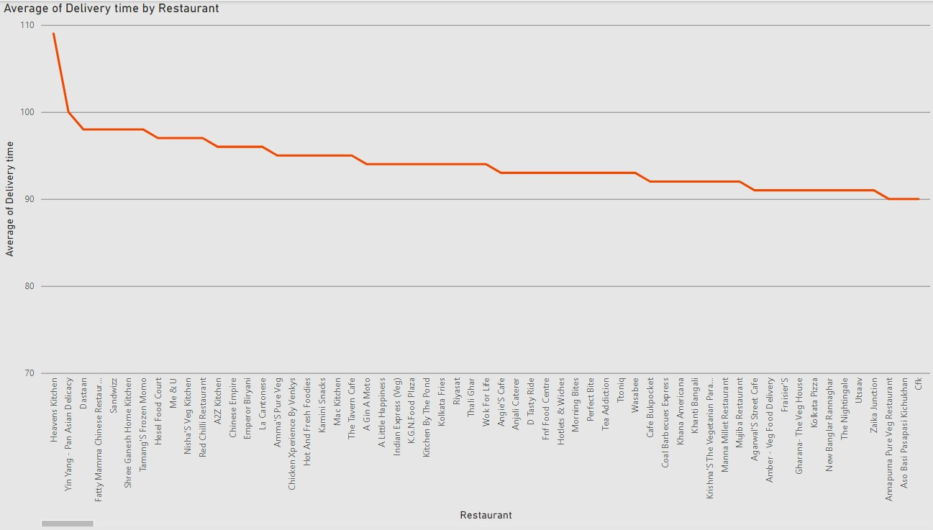
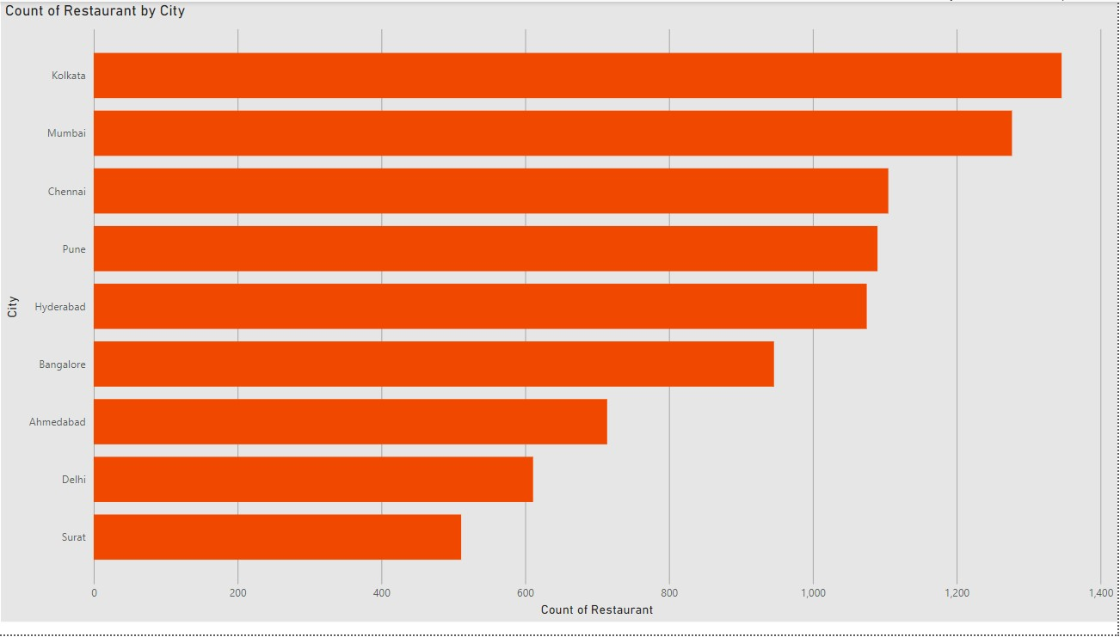
City-wise Restaurant Count
Interpretation:
The high restaurant count in these cities suggests a well-established food service industry, driven by dense populations, tourism, and cultural diversity
Cities like Pune and Bangalore, known for their younger populations and IT workforce, reflect growing food demand. Similarly, Hyderabad's culinary history contributes to its strong showing.
Analysis:
Top Cities by Restaurant Count:
Kolkata leads with the highest number of restaurants, closely followed by Mumbai.
These cities appear to have thriving food cultures and high demand for restaurant services.
Mid-Tier Cities:
Cities like Chennai, Pune, Hyderabad, and Bangalore have a substantial number of restaurants, reflecting their status as major metropolitan areas with growing urban populations and diverse culinary demands.
Lower-Tier Cities:
Ahmedabad, Delhi, and Surat have comparatively fewer restaurants. This could be due to a smaller population base, different culinary habits, or less urban density compared to the top-tier cities.

Slide 8
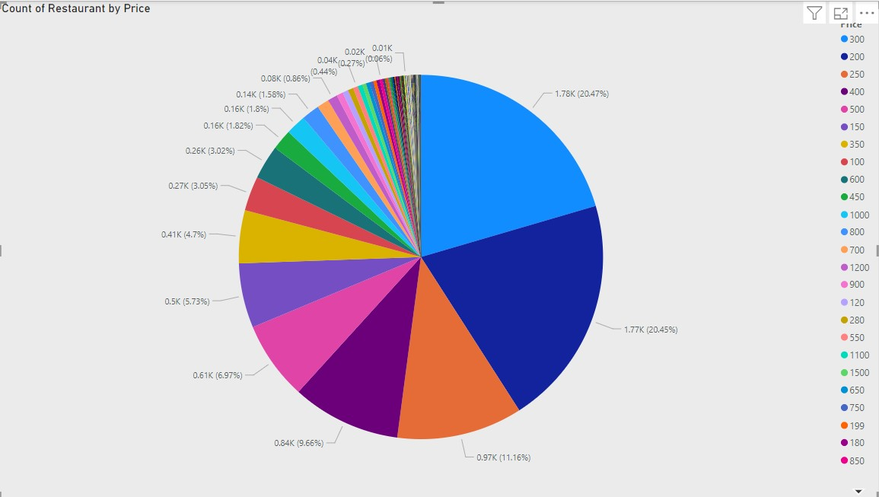
Analyze the price distribution of restaurants
Analysis:
200 and 300 are the most frequent price points, each representing approximately 20.45%-20.47% of the total restaurants.
Price points such as 400, 500, and 600 have significant representation, contributing collectively to approximately 20%-25%
Price points like 800, 900, 1000, and above have lower representation reflecting a smaller market for premium or fine-dining restaurants
Interpretation:
Restaurants priced at 200-300 are the most common, appealing to budget-conscious customers. This reflects the importance of affordability in driving customer choices.
A substantial presence of mid-range prices suggests a demand for restaurants offering slightly elevated experiences, such as casual dining with better ambiance or service.

Slide 9
Analyze the average delivery time of restaurants
Analysis:
Restaurants on the far right of the graph exhibit the lowest average delivery times, hovering around 70 minutes.
The majority of restaurants have average delivery times between 85 and 100 minutes.
There is a noticeable gap between the fastest and slowest restaurants, suggesting variability in operational efficiency, location, or other factors affecting delivery.
Interpretation:
Restaurants with faster delivery likely have optimized operations, shorter preparation times, or are located closer to their delivery zones.
Restaurants with quicker delivery times are likely to provide a better customer experience, potentially increasing customer retention and satisfaction.

Slide 10
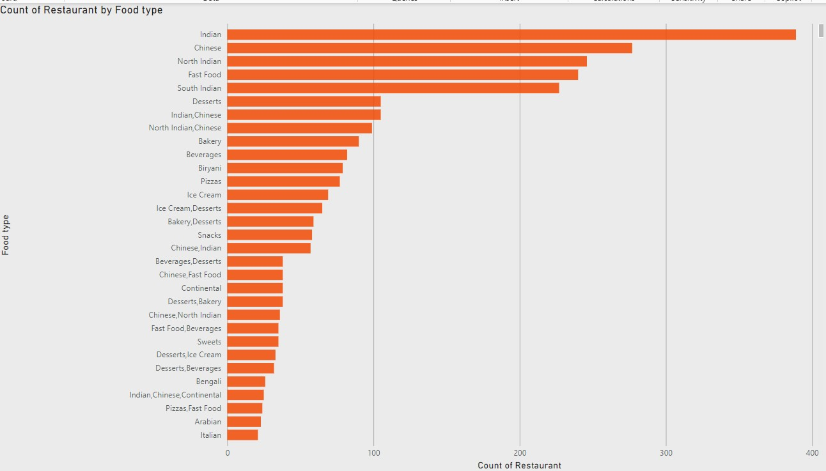
Analyze the variety of cuisines offered by restaurants
Analysis:
Indian cuisine dominates, with the highest number of restaurants specializing in this category (nearly 400 restaurants).
Chinese cuisine follows, with a significant presence but lower than Indian cuisine.
North Indian and Fast Food also feature prominently, showing strong representation
Interpretation:
Indian cuisine's dominance highlights its cultural and regional appeal. Restaurants focusing on Indian food cater to a broad demographic.
The presence of multiple price points, including less frequent ones, suggests a flexible market accommodating diverse customer needs.

Slide 11
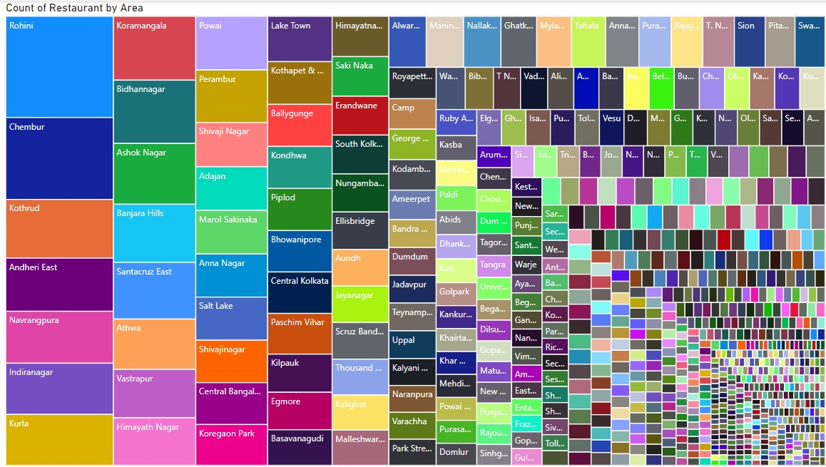
Analyze the number of restaurants
Analysis
Rohini, Koramangala, Powai, Lake Town, and Himayatnagar have the largest rectangles, signifying a high concentration of restaurants.
Areas like Chembur, Kothrud, Banjara Hills, Shivaji Nagar, and Ballygunge have a moderate number of restaurants.
Smaller rectangles represent areas with fewer restaurants these areas might have lower demand or untapped potential for restaurant growth.
Interpretation:
Areas with a high number of restaurants are likely to be urban centers or commercial hubs, catering to diverse demographics, including office-goers, residents, and tourists.
Areas with fewer restaurants may represent untapped markets, offering opportunities for restaurant expansion or new entrants.

Slide 12
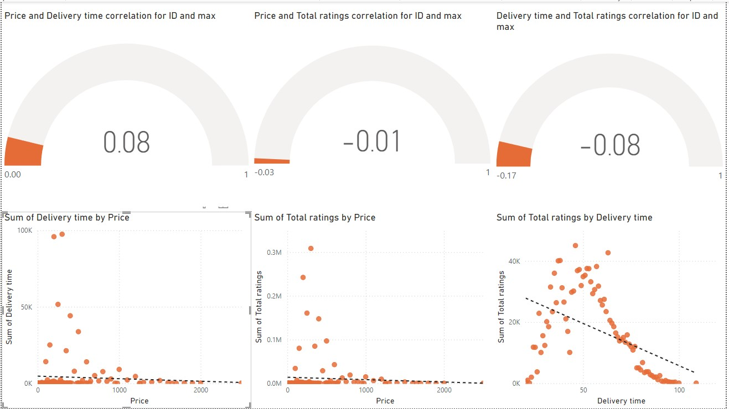
correlations between variables price, ratings, and delivery time
Analysis:
Price and Delivery Time Correlation:
The correlation coefficient is 0.08, indicating a very weak positive relationship between price and delivery time. This means there is almost no meaningful association between these variables.
Price and Total Ratings Correlation:
The correlation coefficient is -0.01, which shows a negligible negative relationship. Price does not significantly influence the number of ratings.
Price and Total Ratings Correlation:
The correlation coefficient is -0.01, which shows a negligible negative relationship. Price does not significantly influence the number of ratings.
Interpretation :
The correlations between price, delivery time, and total ratings are all weak, indicating that these variables do not strongly influence one another.
Price appears to be independent of delivery time and total ratings. Customers rate products without significant regard to price, and delivery times show no predictable relationship with cost.

Slide 13
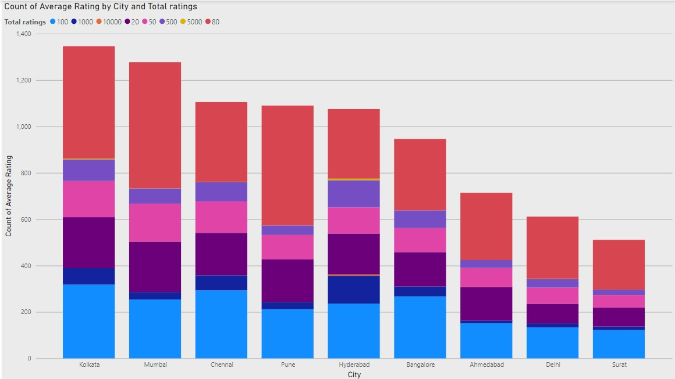
customer feedback based on ratings and total ratings
Analysis :
Kolkata and Mumbai have the highest count of average ratings compared to other cities. Both show strong feedback distribution across all total ratings categories, with substantial contributions from higher ranges
Chennai, Pune, and Hyderabad follow Kolkata and Mumbai closely in terms of total average ratings.
Across all cities, lower total ratings ranges form the base of the bar, indicating that smaller customer bases consistently contribute to the overall feedback.
Interpretation
cities like Kolkata and Mumbai represent markets with larger customer bases and better customer engagement strategies, as they show high feedback volumes
Cities with low rating also form a substantial part of the feedback across all cities. This indicates a consistent level of engagement, even in cities with lower average ratings overall.

Slide 14
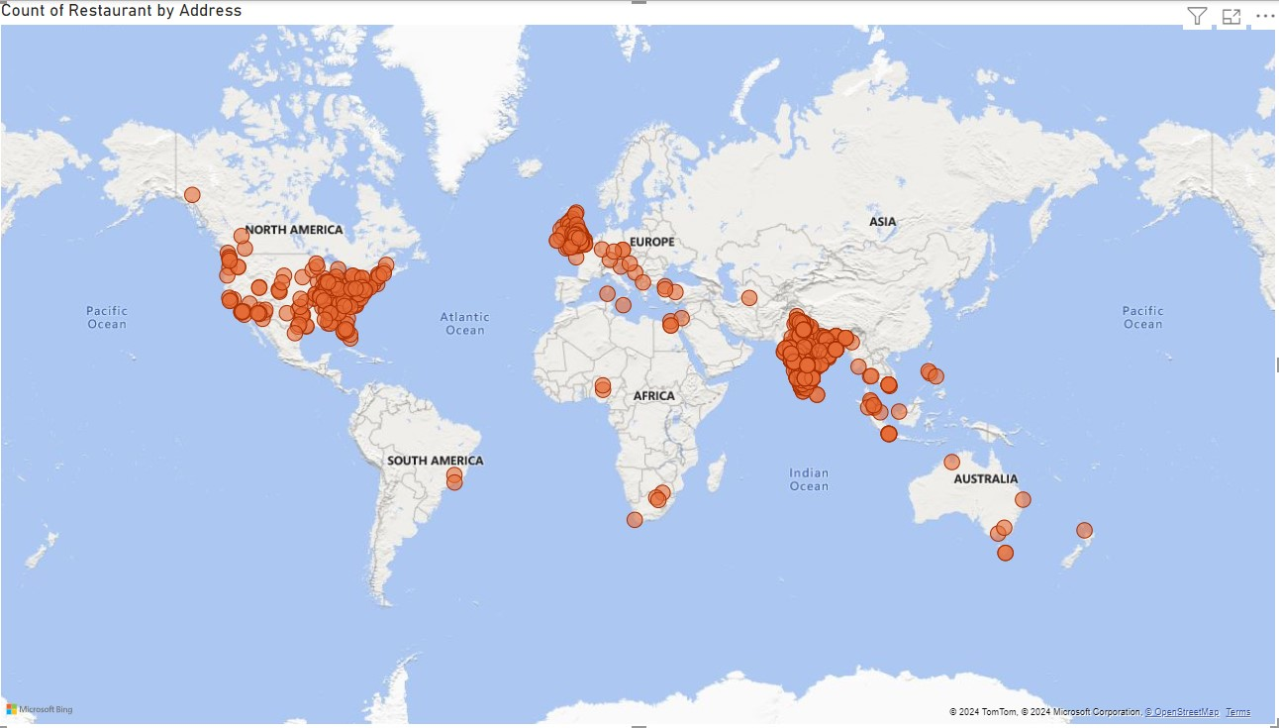
Geographical map of restaurant locations
Analysis:
The map shows a dense cluster of restaurants in India, particularly in its urban and metropolitan areas. This suggests a significant focus on the Indian market.
Australia has a noticeable but smaller cluster of restaurants is visible, primarily in urban centers such as Sydney and Melbourne.
Large parts of Russia, China, and Central Asia have no visible restaurant locations, indicating either minimal market penetration or data absence for these regions.
Interpretation
The high density in India, North America, and Europe highlights these regions as key markets. These areas likely represent significant customer bases and are primary targets for business operations.
Regions like Africa, South America, and Central Asia show minimal activity, indicating potential opportunities for market entry. However, this could also reflect logistical challenges, cultural preferences, or economic constraints.

Slide 15
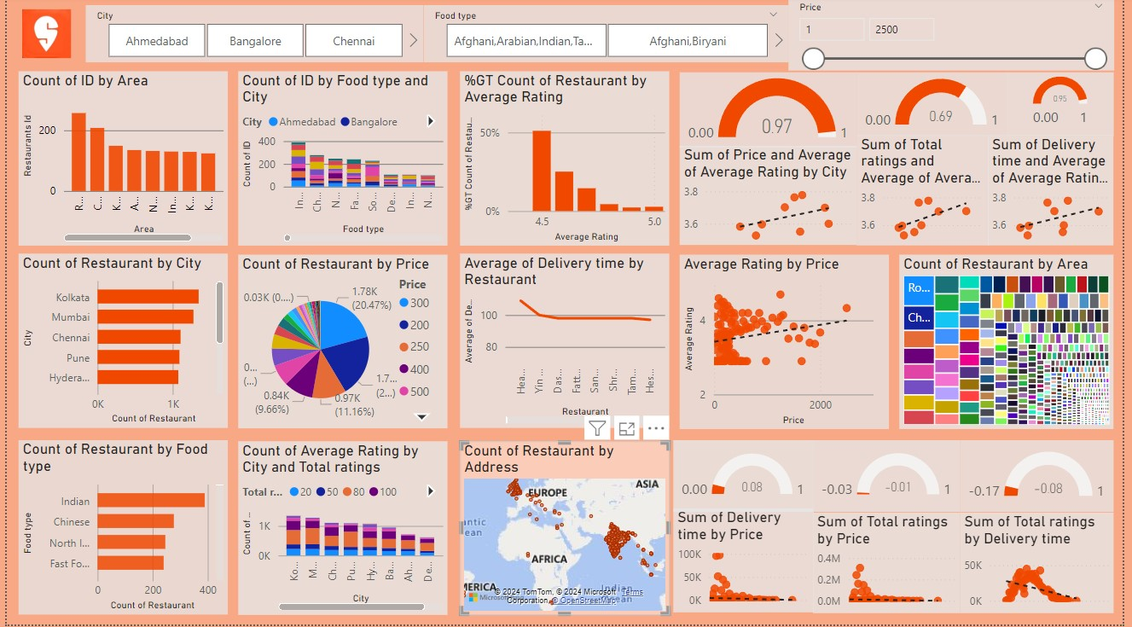
Dashboard

Slide 16
Recommendations for Business Growth:
Leverage High-Demand Areas:
Expand restaurant presence or partnerships in top-performing areas based on high counts by city and area.
Focus on Customer-Centric Pricing:
Use competitive pricing to cater to value-conscious customers while offering premium options for higher price segments.
Promote Popular Food Types:
Highlight Indian and Chinese cuisines through promotions, combos, and discounts.
Improve Delivery Logistics:
Partner with efficient delivery providers and optimize routes to reduce delivery times and enhance ratings.
Use Data to Personalize Marketing:
Tailor campaigns by city, cuisine preferences, and average price brackets to maximize engagement.
Analyze Low-Rating Areas:
Identify and address issues in cities or food types with lower ratings to improve service.

Slide 17
conclusion
This dashboard reveals critical insights into restaurant performance and customer preferences across various metrics. Key findings include the importance of popular food types.
competitive pricing strategies, and the strong correlation between fast delivery times and higher ratings.
Cities like Ahmedabad, Bangalore, and Chennai emerge as high-demand markets, presenting opportunities for targeted expansion and marketing.
To drive business growth, restaurants should focus on enhancing delivery efficiency, optimizing pricing strategies, and tailoring offerings to regional preferences.
By leveraging data-driven decisions, businesses can enhance customer satisfaction, increase market share, and build a stronger presence in competitive markets.

